Slide 1
Covid 19 Data Analysis
File created on: 9/23/2022 5:57:19 PM

Slide 2
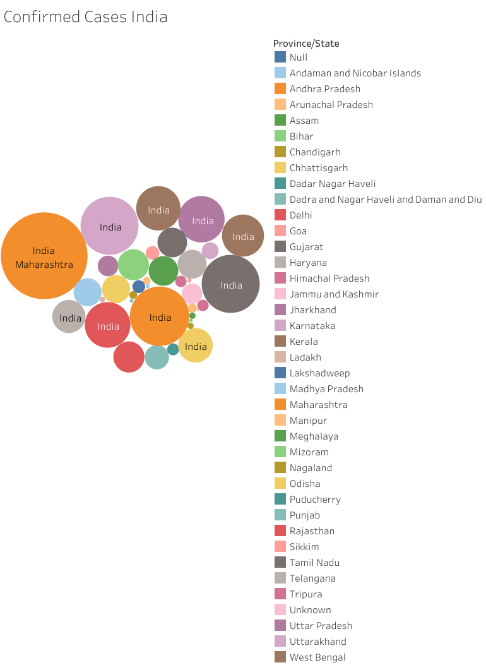

Slide 3
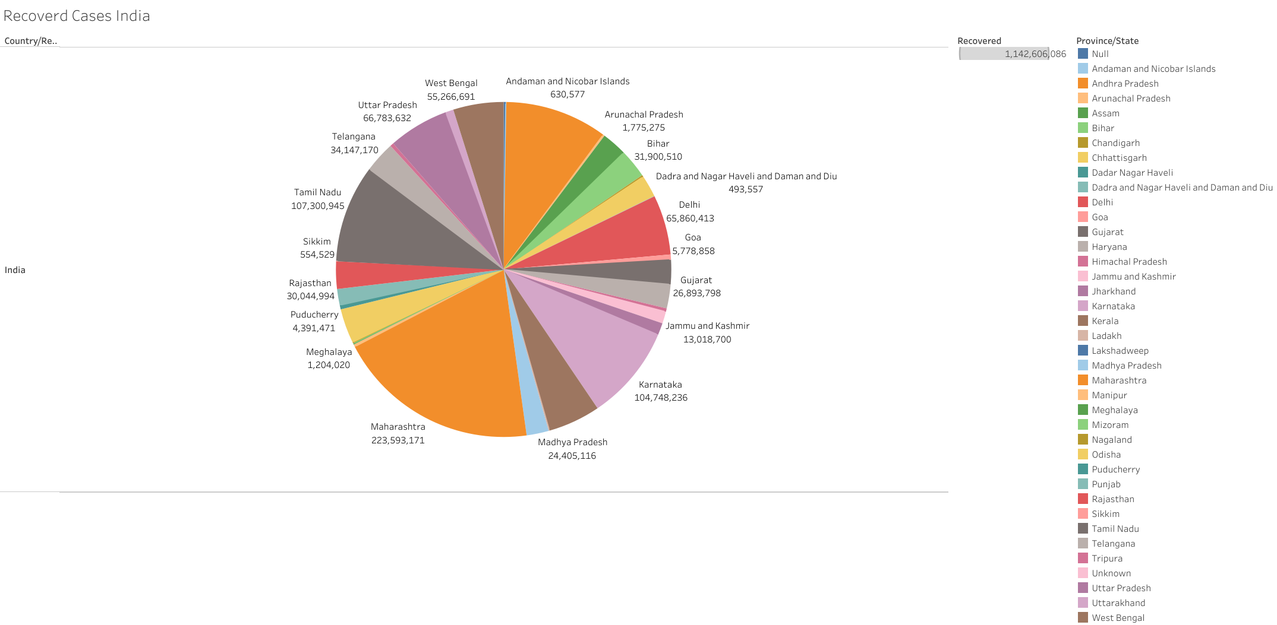

Slide 4
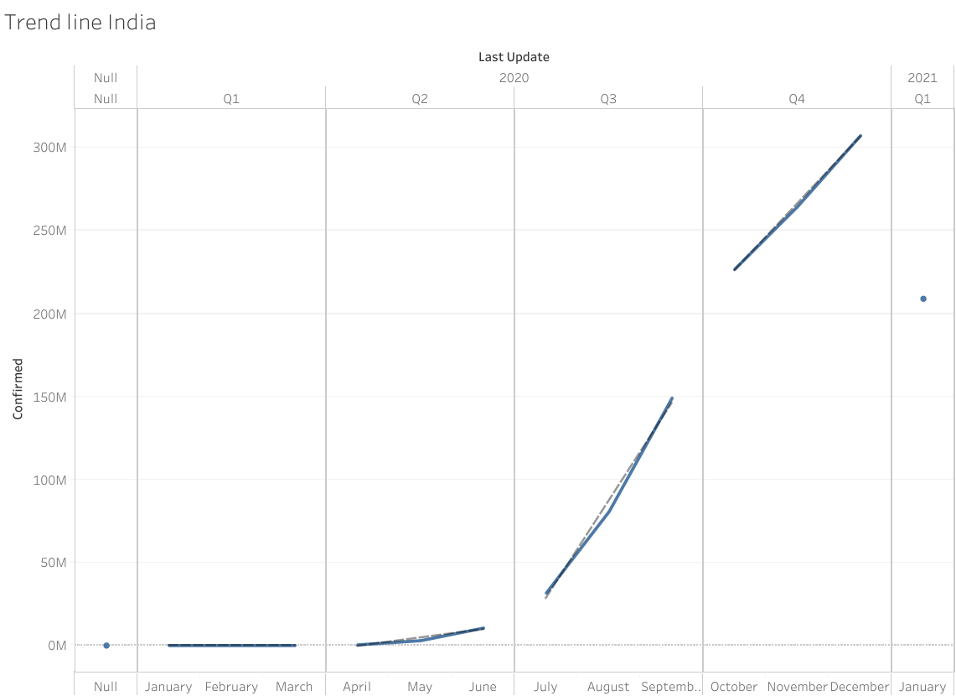

Slide 5
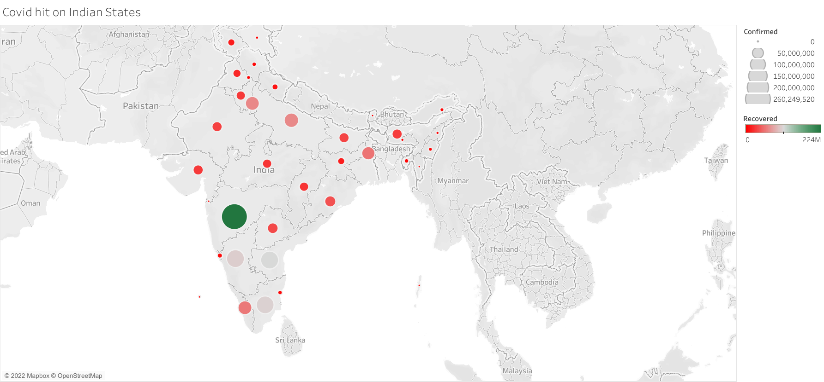

Slide 6
